Slide 1


WEEK 4
SPRINT 1
PL6
REQ

Slide 2


about us.

Slide 3
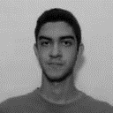
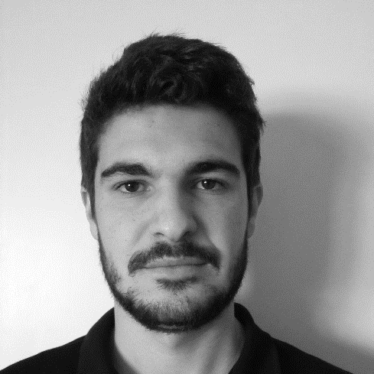
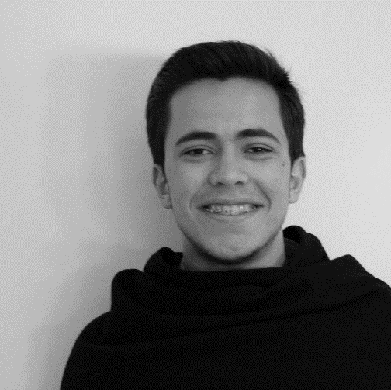
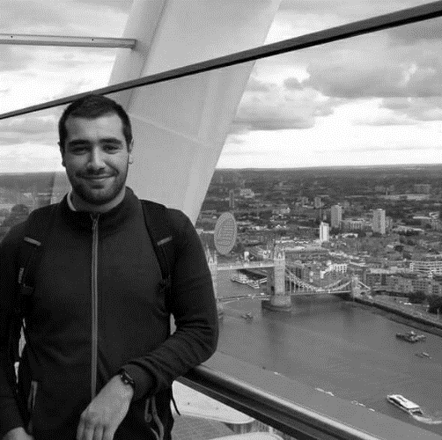
req.
Alexandre
Emanuel
Marco
Paulo

Slide 4
tasks.
 | TASK #1 | TASK #2 | TASK #3 | TASK #4
TASK | Finish the mockups | Meeting with the client | Prepare the weekly presentation | Making of requirement document
OWNER | Alexandre/Emanuel/ Marco | Paulo, Emanuel | Paulo/Emanuel | Paulo
GOAL EFFORT | 4 H | 1 H | 1 H | 8 H
EFFECTIVE EFFORT | 4 H 35 | 0 H 55 | 1 H 10 | 6 H 45
STATUS | COMPLETED | Not completed | COMPLETED | COMPLETED

Slide 5
tasks.
 | TASK #5 | TASK #6 | TASK #7
TASK | Internal Meeting Minute | 1 Meeting with cliente Minute | 2 Meeting with cliente Minute
OWNER | Marco | Alexandre | Emanuel
GOAL EFFORT | 0 H 30 | 0 H 30 | 0 H 30
EFFECTIVE EFFORT | 0 H 45 | - | -
STATUS | COMPLETED | NOT COMPLETED | COMPLETED

Slide 6
planned tasks.
 | TASK #1 | TASK #2 | TASK #3 | Task #4
TASK | Meeting with the client | Update of the requirement document | Update the mockup | Internal meeting
OWNER | Team | Team | Team | team
GOAL EFFORT | 1 H | 6 H | 6 H | 2h
STATUS | IN PROGESS | IN PROGESS | IN PROGESS | IN PROGESS

Slide 7
additional notes.

